Slide 1
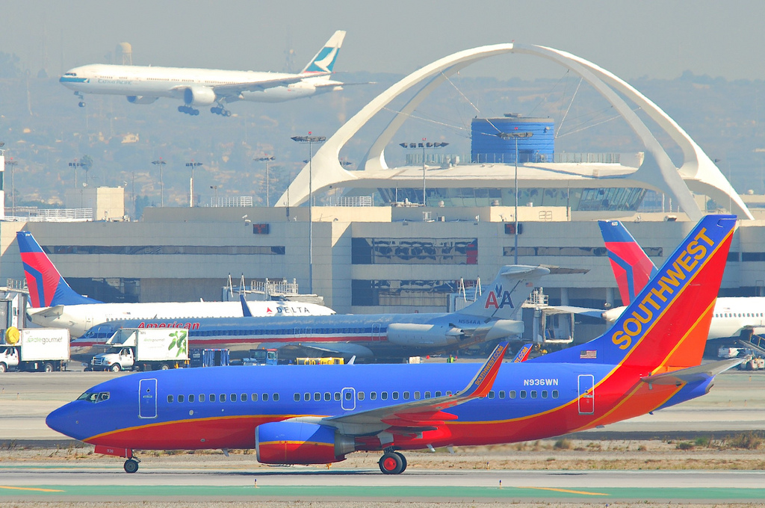
Twitter...
Airlines
on

Slide 2

How are Airlines Performing?
Hundreds or Thousands of tweets online daily
Many tweets are positive
Many tweets are negative

Slide 3
How are we doing?
Hundreds or Thousands of tweets online daily
Many tweets are positive
Many tweets are negative
How do we gather the information to understand the good and the bad?

Slide 4
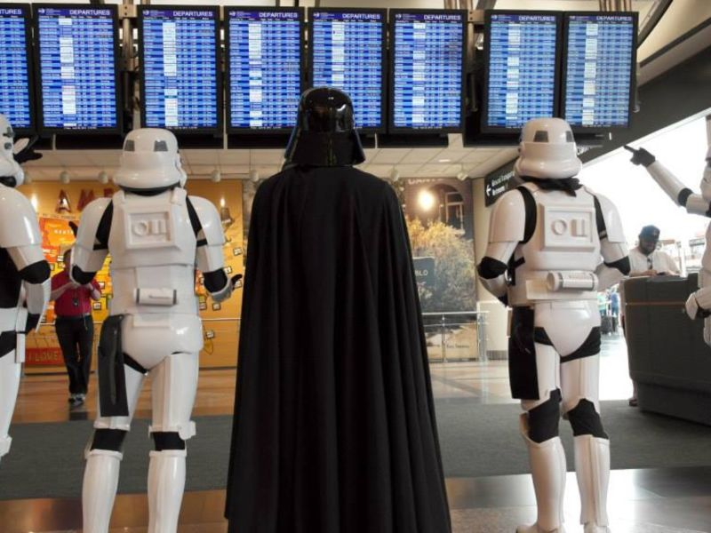
We all get frustrated at the Airport!

Slide 5
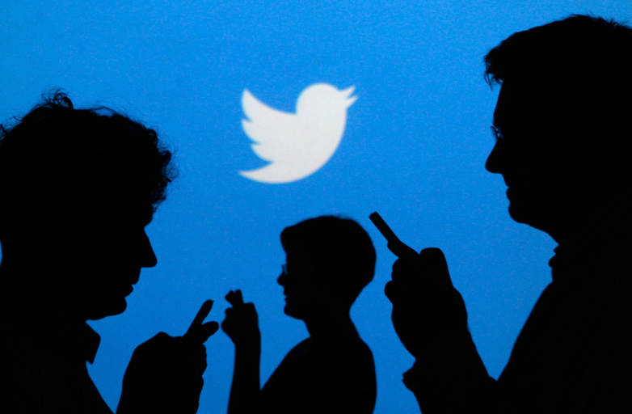
So we tweet about it!

Slide 6
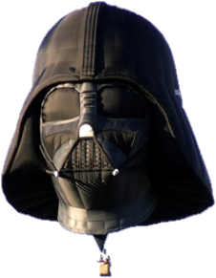






Tools
VADER Sentiment Analysis

Slide 7
Process
AWS EC2 instance
Tweepy.streaming StreamListener
Continuously Collecting Airline Tweets to MongoDB

Slide 8
Process
AWS EC2 instance
Tweepy.streaming - StreamListener
Continuously Collecting Airline Tweets to MongoDB
Local Computer
Vader Sentiment Analysis
0.4 combined Sentiment Scores
LDA Topic Analysis
Top Positive and Negative topics
Top 5 tweets in each group

Slide 9
Process
Must remove Retweets!
Remove near duplicates
Remove other Spam
@ symbols and # hashtags were limited to 3 because of spammers
Increasing the number of topics seemed to increase the percentage of tweets in top topic
Reducing spam increased the diversity of topics

Slide 10
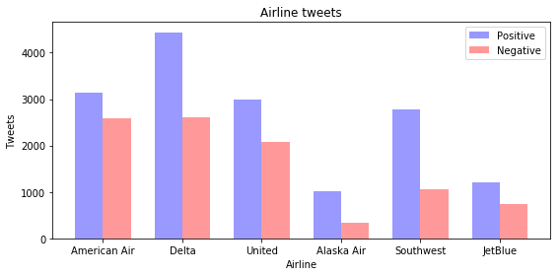
Results with Vader

Slide 11
Results Thanking the airline
@SouthwestAir thanks for the best flight ever and the this is coming from someone who hates to fly #smoothsailing #noturblance #letthefunbegin Thanks @SouthwestAir for happy travels home this Thanksgiving! https://t.co/qKmGqIK3n1 Thx @southwestair for the hitch today! https://t.co/widVCUBgVj https://t.co/WED63l535B

Slide 12
Results Weather Related Delays
@NBCNews snow storm flight delay update: we had a 7 hour delay on @JetBlue and now have been waiting 90 minutes for a gate at ewr! @JetBlue Im trying to get on 4:32 pm flight. Attempted to book JFK-FLL-SAN to avoid bad weather but I have to pay a change fee? I was at my @JetBlue gate for 7 hours before they told me my flight was canceled. Updates were random and were either we are waiting for your flight crew to arrive or no new information at this time. Found out it was canceled because the app no longer showed the flight.

Slide 13
Results JetBlue and Spirit Comparison
@JetBlue . . . Are we going places together? because for 9.5 hours we’ve been trapped https://t.co/8QTyd9HSW6 @JetBlue why is my flight over 3hrs delayed I’ve been here since 6 pm 😭 A four-hour delay @JetBlue?? Youre worse than @SpiritAirlines @shaunking @JetBlue You’ve never been on a Spirit plane, obviously. It can’t be worse than that. @shaunking @JetBlue So you’ve never heard of Spirit? 😭

Slide 14
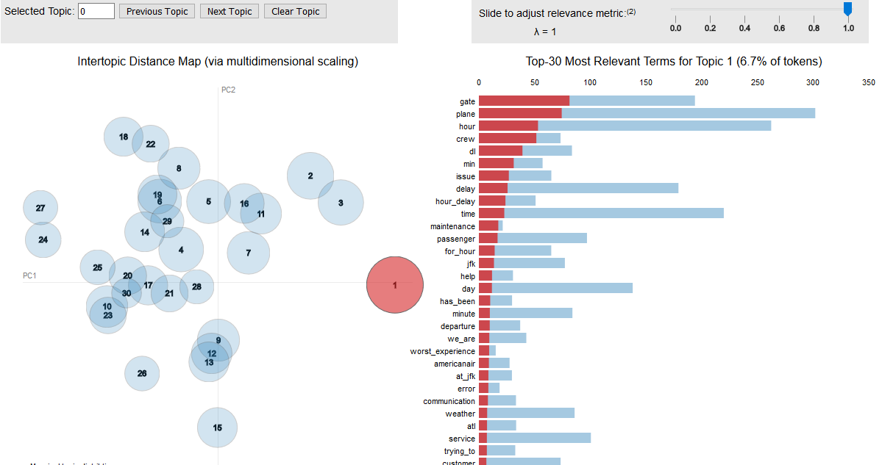
Results Delta Negative

Slide 15
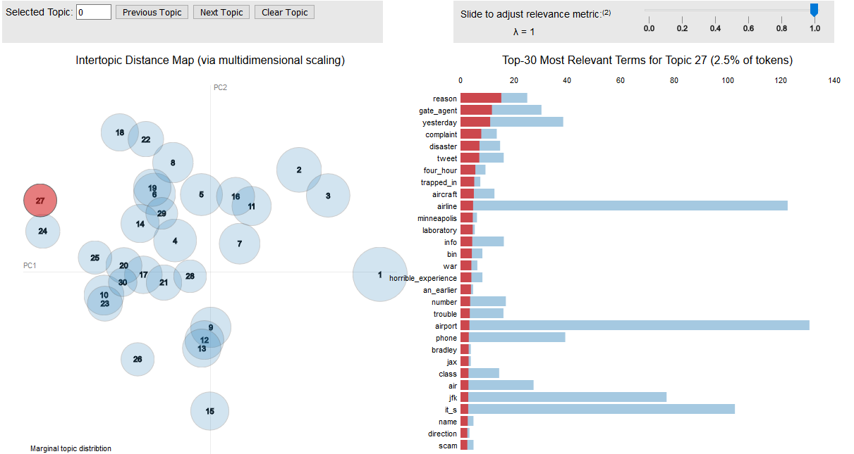
Results Delta Negative

Slide 16
Topic Breakdown
@Delta Positive There were 4502 tweets.
'0.347*"thank" + 0.036*"app" + 0.033*"travel" + 0.024*"snack" + ' '0.024*"message" + 0.016*"atlanta" + 0.016*"biscoff_cookie" + ' '0.013*"do_better" + 0.013*"i_m" + 0.013*"destination"'

Slide 17
Recommendations
Remove retweets, duplicates, and spam every way possible
Use a large number of topics for clearer grouping
Try another model that brings word contextualization with the package such as the Global Vector Model

Slide 18
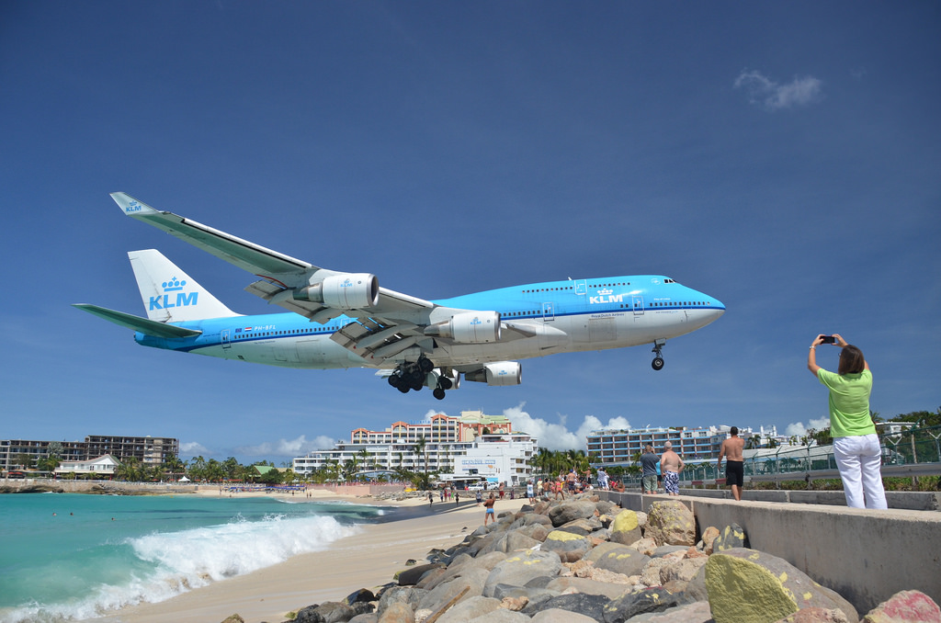
Thank You

Slide 19
Thank You
For flying with us.

